Slide 1
Addition of positive and negative integers
Arithmetic procedures with integers and decimals

Slide 2
how to use Oak lessons

Slide 3
I can use the mathematical structures that underpin addition to add positive and negative integers.

Slide 4
The additive inverse of a number is a number that, when added to the original number, gives the sum of 0.
A number and its additive inverse make a zero pair.
The absolute value of a number is its distance from zero. E.g. 5 and (−5) are both 5 away from zero and so both have an absolute value of 5.

Slide 5

Addition of positive and negative integers
Representing integers using counters
Addition of positive and negative integers
Deepening understanding of addition of integers

Slide 6
Representing integers using counters
What do you notice about the following images?
−5
−4
−3
−2
−1
0
1
2
3
4
5
−5
−4
−3
−2
−1
0
1
2
3
4
5
−5
−4
−3
−2
−1
0
1
2
3
4
5
e.g. They are symmetrical
The dots are on the same numbers in each one but one of them is negative.

Slide 7
Representing integers using counters
−5
−4
−3
−2
−1
0
1
2
3
4
5
The absolute value of a number is its distance from zero.
(−3) is 3 from zero and 3 is 3 from zero
(−3) and 3 both have an absolute value of 3
(−3) and 3 are additive inverses of each other, they sum to zero

Slide 8

Representing integers using counters
The absolute value of 200 and (−200) is 200
One is negative and one is positive.
They are both the same distance from zero.

Slide 9
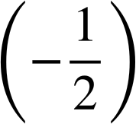

Representing integers using counters
Additive inverses
100
(−100)
(−8)
8
a
(−a)

Slide 10
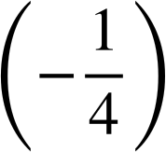
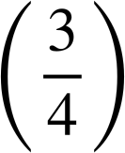
Representing integers using counters
Identify the pairs that are correct additive inverses.
(−82) and 82
h and (−h)
and
0.9 and (−0.9)

Slide 11
Representing integers using counters
Representation of negative numbers using positive and negative counters can be really useful.
You may be able to use two-colour counters. These counters are yellow on one side and red on the other.
Each counter represents 1.
Red side up has a value of negative 1.
Yellow side up has a value of positive 1.
+
−
This is a zero pair.
What is the total of the counters above?

Slide 12
Representing integers using counters
What is the total of the counters?
+
+
−
−
+
+
−
+
−
+
+
+
The total of the counters is 2

Slide 13
Representing integers using counters
What is the total of the counters?
+
+
−
−
+
+
−
−
−
+
−
+
−
−
−
−
The total of the counters is (−2)

Slide 14
Representing integers using counters
What integer do these counters represent?
+
−
−
+
−
+
−
−
+
(−1)

Slide 15
Representing integers using counters
What would you need to add to these counters so that they represent 3?
+
−
−
+
−
+
−
−
+
+
+
+
+

Slide 16



Liu Hui
Liu Hui, a Chinese mathematician (C. 3rd BCE), is potentially the first known mathematician to explain negative numbers in writing.
He created a system of positive numbers (+) in red and negative numbers (-) in black.
What do I owe you?
At the time, Greek mathematicians were struggling with the idea. Liu Hui used the idea of money owed to explain the four operations with negative numbers.
Hm … £5 (R) minus £7 (B) is -£2 … actually I owe you!
Laura
Alex
Notes:
Y7U3L4

Slide 17
Representing integers using counters
Add counters to make each of the representations correct:
Integer | Representation
(−3)
4
(−1)
0
+
+
−
−
+
+
+
−
−
+
−
+
−
+
−
−
−
−
+
+
+
+
+
−
−
+
−
+
−

Slide 18
Representing integers using counters
Add counters to make each of the representations correct:
Answers e.g.
Integer | Representation
(−3)
4
(−1)
0
+
+
−
−
−
−
+
−
−
+
+
+
−
−
+
+
+
−
+
−
+
+
−
−
−
−
+
+
+
+
+
+
+
−
−
−
+
−
+
−
−
−

Slide 19
Addition of positive and negative integers
Representing integers using counters
Addition of positive and negative integers
Deepening understanding of addition of integers

Slide 20
Addition of positive and negative integers
Let us look at calculations using the counters.
4
+
(−2)
= 2
+
+
−
−
+
+
−
+
−
+
+
+

Slide 21
Addition of positive and negative integers
You can draw the counters to help you with a calculation.
3
+
(−5)
= (−2)
+
+
−
−
+
+
−
−
−
+
−
+
−
−
−
−

Slide 22
Addition of positive and negative integers
(−3) + (−2)
= (−5)
−
−
−
+
−
−
−
−
−
−
−

Slide 23
Addition of positive and negative integers
Which is the correct representation of (−4) + 2?
−
−
−
+
−
−
+
−
+
+
−
+
+
+
−
−
+
−
−
+
−

Slide 24
Addition of positive and negative integers
Answer the following questions.
Find the answers in the grid and shade them in to reveal a word.
(−2) + (−2)
5 + (−3)
(−5) + 4
4 + (−7)
9 + (−1)
6) (−4) + 2
7) (−6) + (−2)
8) 7 + (−2)
9) 1 + (−7)
10) 4 + (−11)
(−4) | (−7) | 2 | 1 | (−2) | (−4) | 8 | (−5) | 8 | (−4) | (−7) | 6 | (−3) | 2 | (−6)
(−5) | 6 | (−3) | (−9) | (−7) | 4 | 0 | 4 | (−6) | 3 | (−3) | (−5) | (−8) | (−9) | (−1)
3 | 5 | (−9) | 5 | (−3) | 5 | 6 | (−9) | (−1) | (−3) | (−8) | 7 | 8 | 0 | 5
(−7) | 0 | 7 | 4 | 2 | 7 | 3 | 7 | 5 | (−1) | 6 | 4 | (−4) | 3 | (−7)
(−8) | (−6) | 8 | 0 | (−6) | (−8) | (−7) | (−5) | 2 | 0 | 8 | (−9) | (−1) | 8 | (−3)

Slide 25
Addition of positive and negative integers
Answer the following questions.
Find the answers in the grid and shade them in to reveal a word.
(−2) + (−2)
5 + (−3)
(−5) + 4
4 + (−7)
9 + (−1)
6) (−4) + 2
7) (−6) + (−2)
8) 7 + (−2)
9) 1 + (−7)
10) 4 + (−11)
(−4) | (−7) | 2 | 1 | (−2) | (−4) | 8 | (−5) | 8 | (−4) | (−7) | 6 | (−3) | 2 | (−6)
(−5) | 6 | (−3) | (−9) | (−7) | 4 | 0 | 4 | (−6) | 3 | (−3) | (−5) | (−8) | (−9) | (−1)
3 | 5 | (−9) | 5 | (−3) | 5 | 6 | (−9) | (−1) | (−3) | (−8) | 7 | 8 | 0 | 5
(−7) | 0 | 7 | 4 | 2 | 7 | 3 | 7 | 5 | (−1) | 6 | 4 | (−4) | 3 | (−7)
(−8) | (−6) | 8 | 0 | (−6) | (−8) | (−7) | (−5) | 2 | 0 | 8 | (−9) | (−1) | 8 | (−3)

Slide 26
Addition of positive and negative integers
Answer the following questions.
Find the answers in the grid and shade them in to reveal a word.
(−2) + (−2)
5 + (−3)
(−5) + 4
4 + (−7)
9 + (−1)
6) (−4) + 2
7) (−6) + (−2)
8) 7 + (−2)
9) 1 + (−7)
10) 4 + (−11)
(−4) | (−7) | 2 | 1 | (−2) | (−4) | 8 | (−5) | 8 | (−4) | (−7) | 6 | (−3) | 2 | (−6)
(−5) | 6 | (−3) | (−9) | (−7) | 4 | 0 | 4 | (−6) | 3 | (−3) | (−5) | (−8) | (−9) | (−1)
3 | 5 | (−9) | 5 | (−3) | 5 | 6 | (−9) | (−1) | (−3) | (−8) | 7 | 8 | 0 | 5
(−7) | 0 | 7 | 4 | 2 | 7 | 3 | 7 | 5 | (−1) | 6 | 4 | (−4) | 3 | (−7)
(−8) | (−6) | 8 | 0 | (−6) | (−8) | (−7) | (−5) | 2 | 0 | 8 | (−9) | (−1) | 8 | (−3)

Slide 27
Addition of positive and negative integers
Representing integers using counters
Addition of positive and negative integers
Deepening understanding of addition of integers

Slide 28
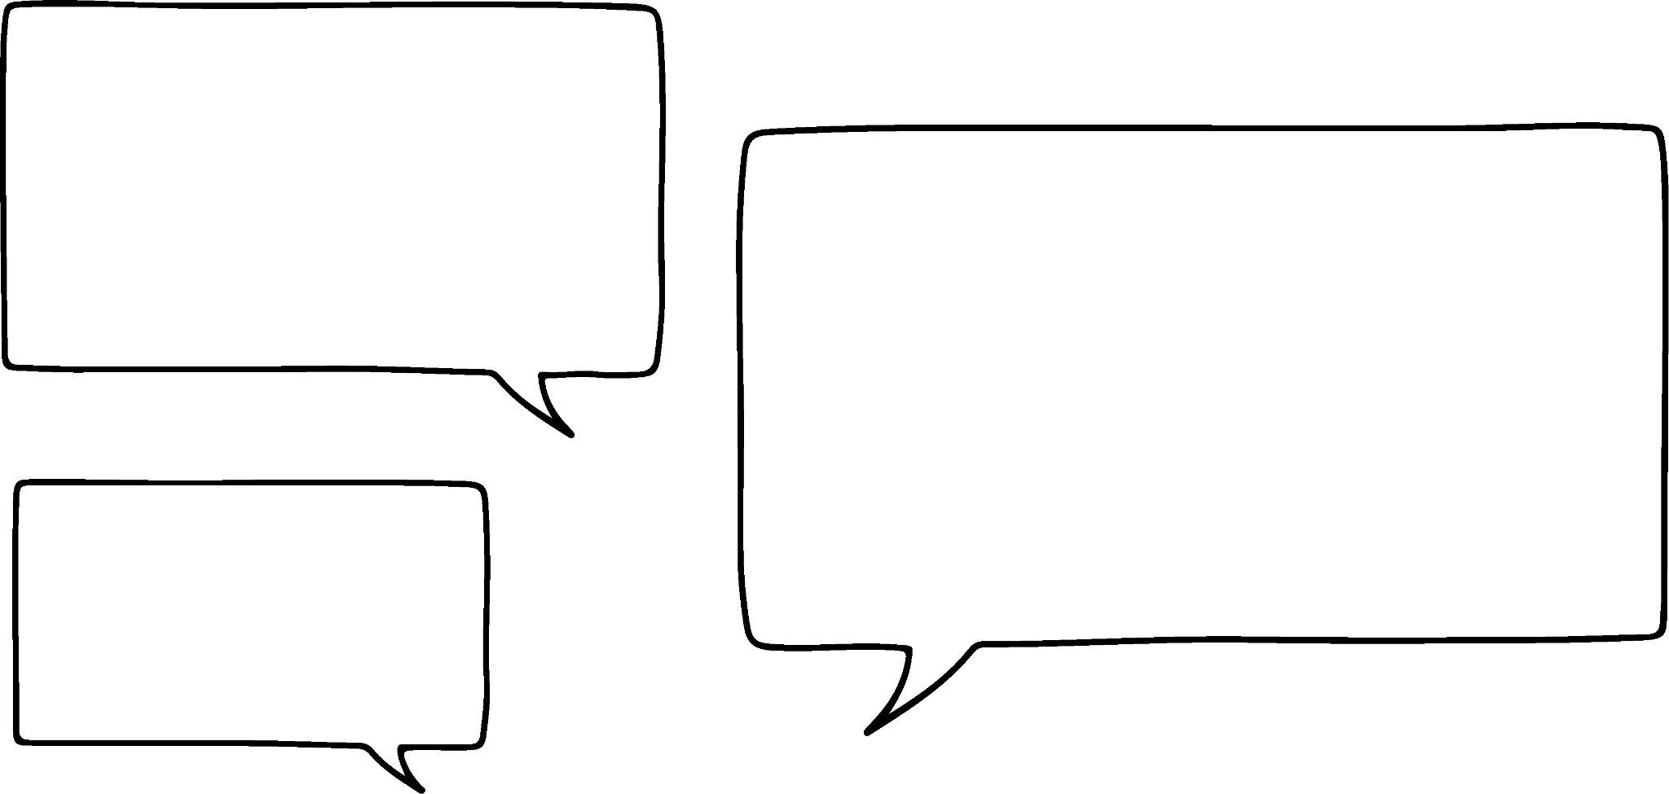


Deepening understanding of addition of integers
(−20) + (−50)
If we drew out the counters what would we draw?
We would draw 20 red counters and then another 50 red counters.

Slide 29
Deepening understanding of addition of integers
(−20) + (−50)
= (−70)
Yes, we would have 70 red counters in total.
So we would only have red counters?

Slide 30
Deepening understanding of addition of integers
(−20) + (−50)
= (−70)
So we can just add the absolute values and make it negative.
Maybe

Slide 31
Deepening understanding of addition of integers
20 + (−50)
We would draw 20 yellow counters and then 50 red counters.
Let’s see if it works for this one.

Slide 32
Deepening understanding of addition of integers
20 + (−50)
= (−30)
That means we would have 30 red counters left.
This time we can make 20 zero pairs.

Slide 33
Deepening understanding of addition of integers
20 + (−50)
= (−30)
Additive inverses
(−20)
(−30)
Oh yes, and we know it will be negative as the negative integer has a greater absolute value than the positive integer.
I’ve noticed that the answer is the difference between the absolute values if you ignore the negative sign.

Slide 34
Deepening understanding of addition of integers
Notice the absolute value of the answers are the same as the sum of the absolute values of the addends.
Only positive counters
32 + 45
= 77
Only negative counters
(−32) + (−45)
= (−77)
addend
addend
sum

Slide 35
Deepening understanding of addition of integers
Notice the absolute value of each sum is the difference between the absolute values of the addends.
More positive counters
(−32) + 45
= 13
More negative counters
32 + (−45)
= (−13)

Slide 36
Deepening understanding of addition of integers
Generalising addition of two integers:
If both integers are positive or both are negative find the sum of their absolute values.
+
=
+
+
=
−
+
+
−
−
If one integer is positive and the other is negative find the difference of their absolute values.
+
−
+
=
+
+
=
−
−
+

Slide 37
Deepening understanding of addition of integers
= (−8)
(−2) + 3 + (−7) + 4 + (−6)
Sum the positive integers and negative integers separately.
Positive integers
Negative integers
3
(−2)
+
4
(−7)
+
(−6)
7
(−15)
The absolute value of the negative integers is greater, so the answer will be negative.
There are positive and negative integers so there will be zero pairs. You need to find the difference between the two absolute values.

Slide 38
Deepening understanding of addition of integers
The answer to (−3) + 5 + (−7) + 2 will be positive
The absolute value of the negative integers is smaller, so the answer will be positive.
The absolute value of the negative integers is greater, so the answer will be negative.

Slide 39
Deepening understanding of addition of integers
72 + (−18)
(−7) + 3 + (−9) + 4 + (−11)
(−110) + (−18)
(−14) + 29 + (−3) + 11 + (−13)
125 + (−45)
(−7) + (−12) + (−24)
(−135) + 82
Make up your own addition question using positive and negative integers so that the sum of all of the answers in this task is 0.

Slide 40
Deepening understanding of addition of integers
72 + (−18) = 54
(−7) + 3 + (−9) + 4 + (−11) = (−20)
(−110) + (−18) = (−128)
(−14) + 29 + (−3) + 11 + (−13) = 10
125 + (−45) = 80
(−7) + (−12) + (−24) = (−43)
(−135) + 82 = (−53)
Make up your own addition question using positive and negative integers so that the sum of all of the answers in this task is 0. e.g. (−80) + 180 or any sum equal to 100

Slide 41
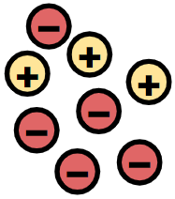
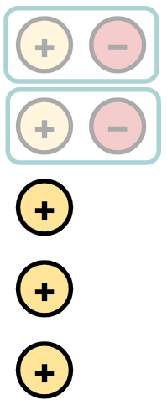

Addition of positive and negative integers
Integers can be represented with positive and negative counters.
E.g. These counters are a representation of (−2)
Counters can be used to represent addition of positive and negative integers.
Zero pairs can be used to simplify addition of positive and negative integers. E.g.
Absolute values are useful when adding positive and negative integers.

Slide 42

© Oak National Academy 2023.
Produced in partnership with Mathematics in Education and Industry.
Licensed on the Open Government Licence v3.0, except where otherwise stated. See Oak terms and conditions.

